Slide 1

System Programming
CSE 401
(lecture 1)
Md.Julkar Nayeen Mahi
Lecturer, City University
© 2008 Morgan Kaufman
Computers as Components Wayne Wolf

Slide 2
Introduction
What are embedded computing systems?
Challenges in embedded computing system design.
Design methodologies.
© 2008 Morgan Kaufman
Computers as Components Wayne Wolf

Slide 3
Definition
Embedded computing system: any device that includes a programmable computer but is not itself a general-purpose computer.
Take advantage of application characteristics to optimize the design:
  don’t need all the general-purpose bells and whistles.
Computers as Components Wayne Wolf

Slide 4

Embedding a computer
output
analog
CPU
input
analog
mem
embedded
computer
Computers as Components Wayne Wolf

Slide 5
Examples
Cell phone.
Printer.
Automobile: engine, brakes, dash, etc.
Airplane: engine, flight controls, nav/comm.
Digital television.
Household appliances.
Computers as Components Wayne Wolf

Slide 6
Early history
Late 1940’s: MIT Whirlwind computer was designed for real-time operations.
  Originally designed to control an aircraft simulator.
First microprocessor was Intel 4004 in early 1970’s.
HP-35 calculator used several chips to implement a microprocessor in 1972.
Computers as Components Wayne Wolf

Slide 7
Early history, cont’d.
Automobiles used microprocessor-based engine controllers starting in 1970’s.
  Control fuel/air mixture, engine timing, etc.
  Multiple modes of operation: warm-up, cruise, hill climbing, etc.
  Provides lower emissions, better fuel efficiency.
Computers as Components Wayne Wolf

Slide 8
Microprocessor varieties
Microcontroller: includes I/O devices, on-board memory.
Digital signal processor (DSP): microprocessor optimized for digital signal processing.
Typical embedded word sizes: 8-bit, 16-bit, 32-bit.
Computers as Components Wayne Wolf

Slide 9
Application examples
Simple control: front panel of microwave oven, etc.
Canon EOS 3 has three microprocessors.
  32-bit RISC CPU runs autofocus and eye control systems.
Digital TV: programmable CPUs + hardwired logic for video/audio decode, menus, etc.
Computers as Components Wayne Wolf

Slide 10
Automotive embedded systems
Today’s high-end automobile may have 100 microprocessors:
  4-bit microcontroller checks seat belt;
  microcontrollers run dashboard devices;
  16/32-bit microprocessor controls engine.
Computers as Components Wayne Wolf

Slide 11
BMW 850i brake and stability control system
Anti-lock brake system (ABS): pumps brakes to reduce skidding.
Automatic stability control (ASC+T): controls engine to improve stability.
ABS and ASC+T communicate.
  ABS was introduced first---needed to interface to existing ABS module.
Computers as Components Wayne Wolf

Slide 12
BMW 850i, cont’d. (Cyber Physical Systems)
sensor
sensor
brake
brake
ABS
hydraulic
pump
brake
brake
sensor
sensor
Computers as Components Wayne Wolf

Slide 13
Characteristics of embedded systems
Sophisticated functionality.
Real-time operation.
Low manufacturing cost.
Low power.
Designed to tight deadlines by small teams.
Computers as Components Wayne Wolf

Slide 14
Functional complexity
Often have to run sophisticated algorithms or multiple algorithms.
  Cell phone, laser printer.
Often provide sophisticated user interfaces.
Computers as Components Wayne Wolf

Slide 15
Real-time operation
Must finish operations by deadlines.
  Hard real time: missing deadline causes failure.
  Soft real time: missing deadline results in degraded performance.
Many systems are multi-rate: must handle operations at widely varying rates.
Computers as Components Wayne Wolf

Slide 16
Non-functional requirements
Many embedded systems are mass-market items that must have low manufacturing costs.
  Limited memory, microprocessor power, etc.
Power consumption is critical in battery-powered devices.
  Excessive power consumption increases system cost even in wall-powered devices.
Computers as Components Wayne Wolf

Slide 17
Design teams
Often designed by a small team of designers.
Often must meet tight deadlines.
  6 month market window is common.
  Can’t miss back-to-school window for calculator.
Computers as Components Wayne Wolf

Slide 18
Why use microprocessors?
Alternatives: field-programmable gate arrays (FPGAs), custom logic, etc.
Microprocessors are often very efficient: can use same logic to perform many different functions.
Microprocessors simplify the design of families of products.
Computers as Components Wayne Wolf

Slide 19
The performance paradox
Microprocessors use much more logic to implement a function than does custom logic.
But microprocessors are often at least as fast:
  heavily pipelined;
  large design teams;
  aggressive VLSI technology.
Computers as Components Wayne Wolf

Slide 20
Power
Custom logic uses less power, but CPUs have advantages:
  Modern microprocessors offer features to help control power consumption.
  Software design techniques can help reduce power consumption.
Heterogeneous systems: some custom logic for well-defined functions, CPUs+software for everything else.
Computers as Components Wayne Wolf

Slide 21
Platforms
Embedded computing platform: hardware architecture + associated software.
Many platforms are multiprocessors.
Examples:
  Single-chip multiprocessors for cell phone baseband.
  Automotive network + processors.
Computers as Components Wayne Wolf

Slide 22
The physics of software
Computing is a physical act.
  Software doesn’t do anything without hardware.
Executing software consumes energy, requires time.
To understand the dynamics of software (time, energy), we need to characterize the platform on which the software runs.
Computers as Components Wayne Wolf

Slide 23
What does “performance” mean?
In general-purpose computing, performance often means average-case, may not be well-defined.
In real-time systems, performance means meeting deadlines.
  Missing the deadline by even a little is bad.
  Finishing ahead of the deadline may not help.
Computers as Components Wayne Wolf

Slide 24
Characterizing performance
We need to analyze the system at several levels of abstraction to understand performance:
  CPU.
  Platform.
  Program.
  Task.
  Multiprocessor.
Computers as Components Wayne Wolf

Slide 25
Challenges in embedded system design
How much hardware do we need?
  How big is the CPU? Memory?
How do we meet our deadlines?
  Faster hardware or cleverer software?
How do we minimize power?
  Turn off unnecessary logic? Reduce memory accesses?
Computers as Components Wayne Wolf

Slide 26
Challenges, etc.
Does it really work?
  Is the specification correct?
  Does the implementation meet the spec?
  How do we test for real-time characteristics?
  How do we test on real data?
How do we work on the system?
  Observability, controllability?
  What is our development platform?
Computers as Components Wayne Wolf

Slide 27
Design methodologies
A procedure for designing a system.
Understanding your methodology helps you ensure you didn’t skip anything.
Compilers, software engineering tools, computer-aided design (CAD) tools, etc., can be used to:
  help automate methodology steps;
  keep track of the methodology itself.
Computers as Components Wayne Wolf

Slide 28
Design goals
Performance.
  Overall speed, deadlines.
Functionality and user interface.
Manufacturing cost.
Power consumption.
Other requirements (physical size, etc.)
Computers as Components Wayne Wolf

Slide 29
Levels of abstraction
requirements
specification
architecture
component
design
system
integration
Computers as Components Wayne Wolf

Slide 30
Top-down vs. bottom-up
Top-down design:
  start from most abstract description;
  work to most detailed.
Bottom-up design:
  work from small components to big system.
Real design uses both techniques.
Computers as Components Wayne Wolf

Slide 31
Stepwise refinement
At each level of abstraction, we must:
  analyze the design to determine characteristics of the current state of the design;
  refine the design to add detail.
Computers as Components Wayne Wolf

Slide 32
Requirements
Plain language description of what the user wants and expects to get.
May be developed in several ways:
  talking directly to customers;
  talking to marketing representatives;
  providing prototypes to users for comment.
Computers as Components Wayne Wolf

Slide 33
Functional vs. non-functional requirements
Functional requirements:
  output as a function of input.
Non-functional requirements:
  time required to compute output;
  size, weight, etc.;
  power consumption;
  reliability;
  etc.
Computers as Components Wayne Wolf

Slide 34
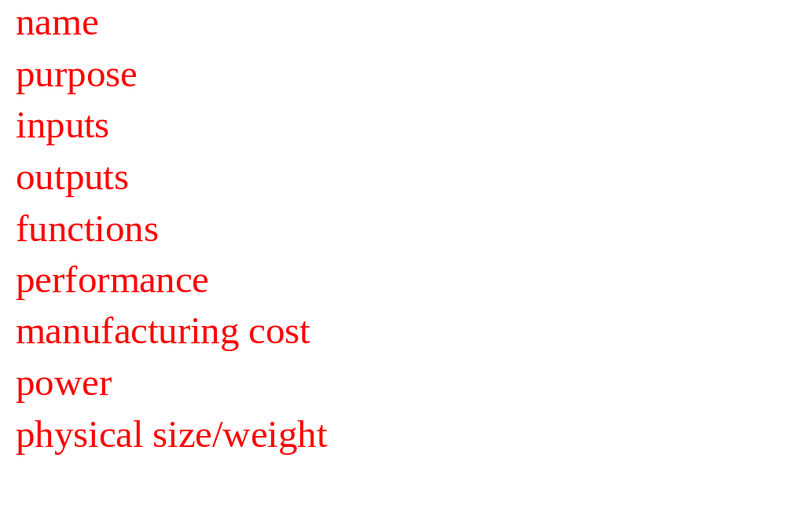
Our requirements form
Computers as Components Wayne Wolf

Slide 35
Example: GPS moving map requirements
Moving map obtains position from GPS, paints map from local database.
I-78
Scotch Road
lat: 40 13 lon: 32 19
Computers as Components Wayne Wolf

Slide 36
GPS moving map needs
Functionality: For automotive use. Show major roads and landmarks.
User interface: At least 400 x 600 pixel screen. Three buttons max. Pop-up menu.
Performance: Map should scroll smoothly. No more than 1 sec power-up. Lock onto GPS within 15 seconds.
Cost: $120 street price = approx. $30 cost of goods sold.
Computers as Components Wayne Wolf

Slide 37
GPS moving map needs, cont’d.
Physical size/weight: Should fit in hand.
Power consumption: Should run for 8 hours on four AA batteries.
Computers as Components Wayne Wolf

Slide 38
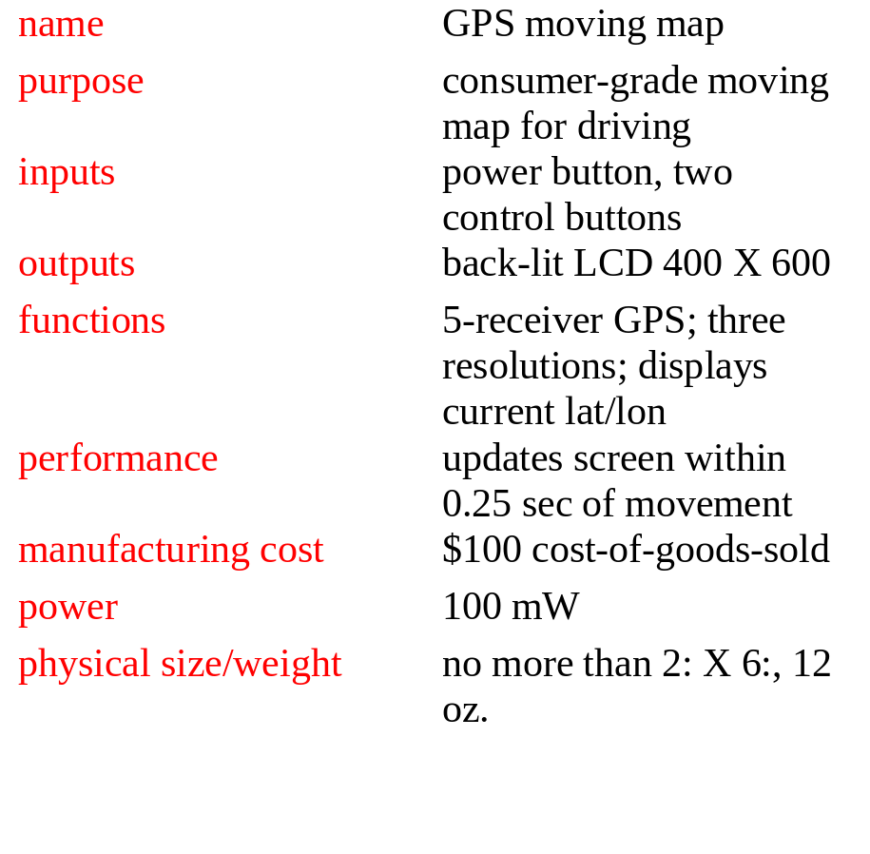
GPS moving map requirements form
Computers as Components Wayne Wolf

Slide 39
Specification
A more precise description of the system:
  should not imply a particular architecture;
  provides input to the architecture design process.
May include functional and non-functional elements.
May be executable or may be in mathematical form for proofs.
Computers as Components Wayne Wolf

Slide 40
GPS specification
Should include:
  What is received from GPS;
  map data;
  user interface;
  operations required to satisfy user requests;
  background operations needed to keep the system running.
Computers as Components Wayne Wolf

Slide 41
Architecture design
What major components go satisfying the specification?
Hardware components:
  CPUs, peripherals, etc.
Software components:
  major programs and their operations.
Must take into account functional and non-functional specifications.
Computers as Components Wayne Wolf

Slide 42

GPS moving map block diagram
GPS
receiver
search
engine
renderer
display
database
user
interface

Slide 43
GPS moving map hardware architecture
display
frame
buffer
CPU
GPS
receiver
memory
panel I/O

Slide 44
GPS moving map software architecture
position
database
search
renderer
pixels
user
interface
timer

Slide 45
Designing hardware and software components
Must spend time architecting the system before you start coding.
Some components are ready-made, some can be modified from existing designs, others must be designed from scratch.

Slide 46
System integration
Put together the components.
  Many bugs appear only at this stage.
Have a plan for integrating components to uncover bugs quickly, test as much functionality as early as possible.

Slide 47
Summary
Embedded computers are all around us.
  Many systems have complex embedded hardware and software.
Embedded systems pose many design challenges: design time, deadlines, power, etc.
Design methodologies help us manage the design process.

